Slide 1
TCM Substitution
Preliminary Air Emission Reduction Analysis
December 2, 2014

Slide 2
Introduction
Project LAE0332: Long Beach Park and Ride Lot Facility needs to be replaced
Total number of Parking Spaces: 400
Metro is considering the substitution of LAE0332 with following seven (7) projects
Two (2) PRL projects: LAF1414, LA0G598
Five (5) Class I & Class II bike path/lane projects: LAF3515, LAF5514, LAF5518, LAF5627, LAEG1130
Total number of Parking Spaces: 162
Total length of Bike path/lane: 10 miles

Slide 3
Project Details
Original Project
Projects to be used as substitution
Project ID | Agency | Title | Relevant Project Component | Completion Date
LAE0332 | City of Long Beach | Long Beach Park & Ride Lot | PRL with 400 parking spaces | June, 2014
Project ID | Agency | Title | Relevant Project Component | Completion Date
LA0G1130 | Carson, City of | Citywide Bike and Pedestrian Improvements | 1.1 mile Class II bike lane | Dec, 2016
LAF5627 | Duarte, City of | Duarte Gold Line Station Pedestrian & Bike Improvements | 1.9 mile Class I bike path | Oct, 2016
LAF3515 | Los Angeles, City of | San Fernando Road Bike Path Phase III | 2.5 mile Class I bike path | Jan, 2016
LAF5518 | Los Angeles, City of | LA River Bike Path | 1.5 mile Class I bike path | Dec,2016
LAF1414 | Los Angeles, County of | Third Street & La Verne Avenue Parking Lot | PRL with 87 parking spaces | Oct, 2016
LAF5514 | Los Angeles, County of | Vermont Avenue Bike Lane | 3.0 mile Class II bike lane | Dec, 2016
LA0G598 | Westlake Village, City of | Thousands Oaks Boulevard Park & Ride Facility | PRL with 75 parking spaces | Oct, 2016

Slide 4
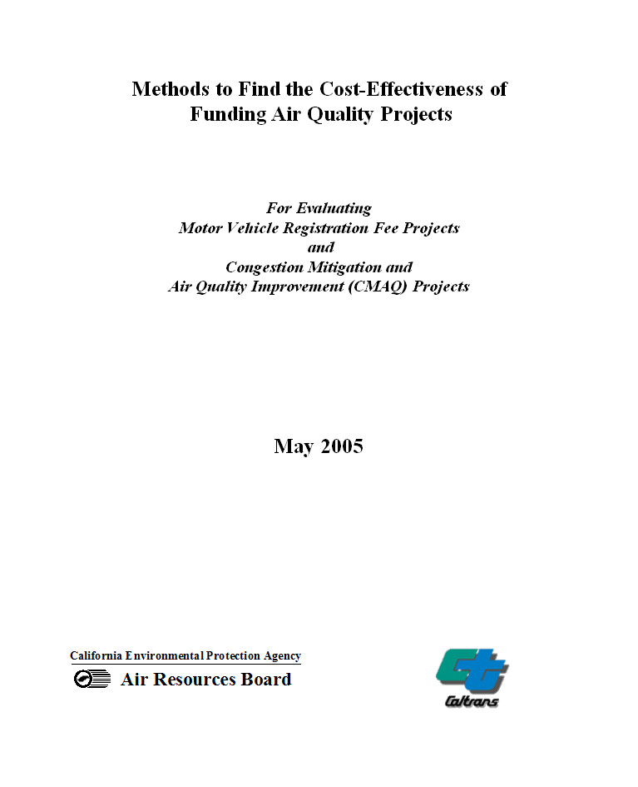
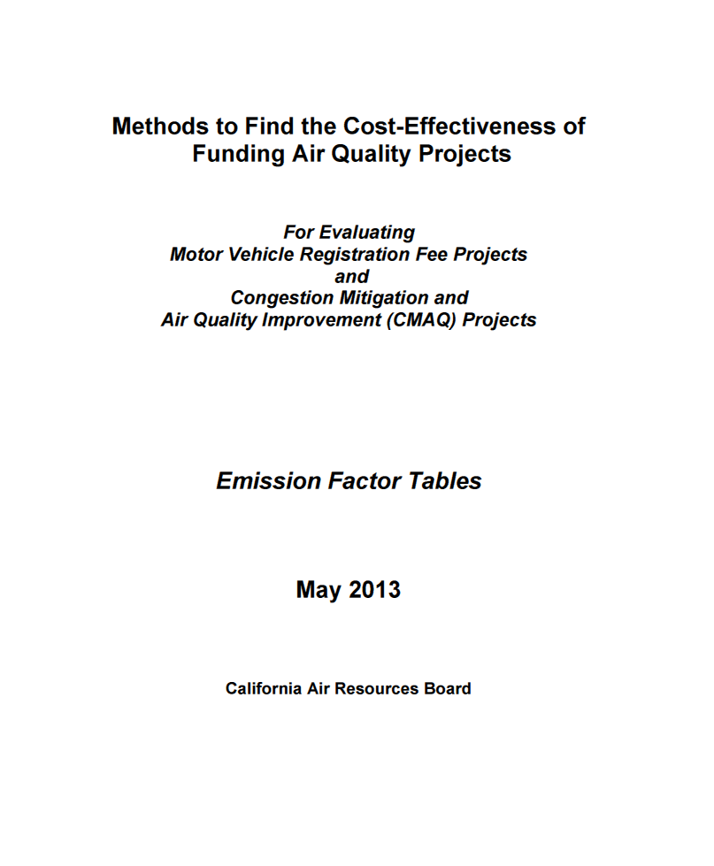
Methodology
Using “Methods to Find the Cost-Effectiveness of Funding Air Quality Projects” by California Air Resources Board (2013)
- http://www.arb.ca.gov/planning/tsaq/eval/eval.htm

Slide 5
Emission Reduction Estimation Process
Collect Substitute Project(s) Info
Collect Original Project Info
6
1
Estimate Trip Reduction
Estimate Trip Reduction
7
2
Estimate VMT Reduction
Estimate VMT Reduction
8
3
Estimate Emission Reduction
Estimate Emission Reduction
9
4
Compare Emission Reduction
Identify Substitute Project(s)
10
5
No
<=
4
9
Yes
Complete the Process
11

Slide 6
Emission Reduction Results
Emission reduction by substitution projects (lbs)
Year | ROG | CO | NOx | PM2.5
2016 | 287.1 | 2,784.2 | 213.3 | 62.5
2023 | 256.3 | 2,308.0 | 187.1 | 69.5
2035 | 230.9 | 2,199.3 | 163.7 | 82.5
Emission reduction by original project (lbs)
Year | ROG | CO | NOx | PM2.5
2016 | 170.6 | 1,855.4 | 165.8 | 60.7
2023 | 153.5 | 1,618.2 | 147.1 | 68.1
2035 | 140.8 | 1,493.7 | 131.1 | 80.8
Comparison: Substitution - Original (lbs)
Year | ROG | CO | NOx | PM2.5
2016 | 116.5 | 928.8 | 47.6 | 1.7
2023 | 102.8 | 689.8 | 39.9 | 1.4
2035 | 90.1 | 705.6 | 32.5 | 1.7

Slide 7
Emission Reduction Comparison
Improved Emission Reduction by Substitution Projects (%)

Slide 8
Next Steps
Collect comments from TCWG meeting
Incorporate comments into the emission reduction analysis
Prepare TCM Substitution Report
TCM Substitution Request

